Slide 1
Writing for CET-4
Tips and Techniques for Effective Exam Writing

Slide 2
Objectives
Understand CET-4 writing task types and requirements
Master essential essay structure and high-scoring expressions
Practice time-management skills for timed writing

Slide 3
Objectives
Exam Relevance: CET-4 Writing Section is worth 15% of the total score, essential for passing and scoring high.
Purpose of This Lesson: To help you structure, organize, and express ideas effectively in English.

Slide 4
Overview of Writing

Slide 5
Writing Task Types
Argumentative Essay:
Purpose: Present and defend a particular opinion on a given topic.
Structure: Introduction with a thesis statement, body paragraphs with supporting arguments and examples, and a conclusion summarizing the main point.
Example: Should college students work part-time?

Slide 6
Writing Task Types
Expository Essay:
Purpose: Explain or describe a topic, process, or concept without arguing a viewpoint.
Structure: Introduction presenting the topic, body paragraphs detailing explanations or aspects, and a conclusion encapsulating (概括) the discussion.
Example: The impact of technology on education.

Slide 7
Writing Task Types
Problem-solution Essay:
Purpose: Identify a specific problem and propose solutions.
Structure: Introduction stating the problem, body paragraphs outlining possible solutions with explanations, and a conclusion reinforcing the proposed solutions.
Example: How to reduce waste on campus?

Slide 8
Writing Task Types
Practical Writing:
Purpose: Communicate practical information in a formal or semi-formal manner.
Structure: Varies by type but generally includes a clear introduction, detailed content, and a polite closing.
Example: Write a letter of application for a scholarship.
Write a proposal for organizing a community event.
Write a summary of news, papers, etc.

Slide 9
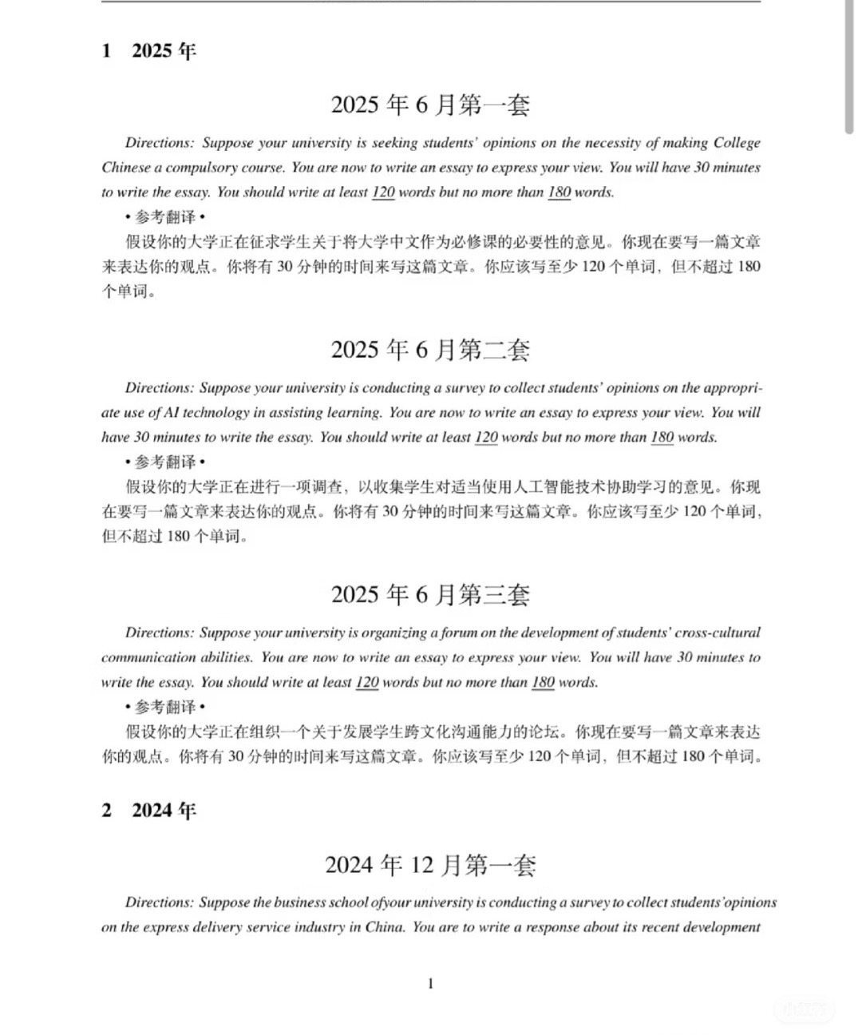

Slide 10
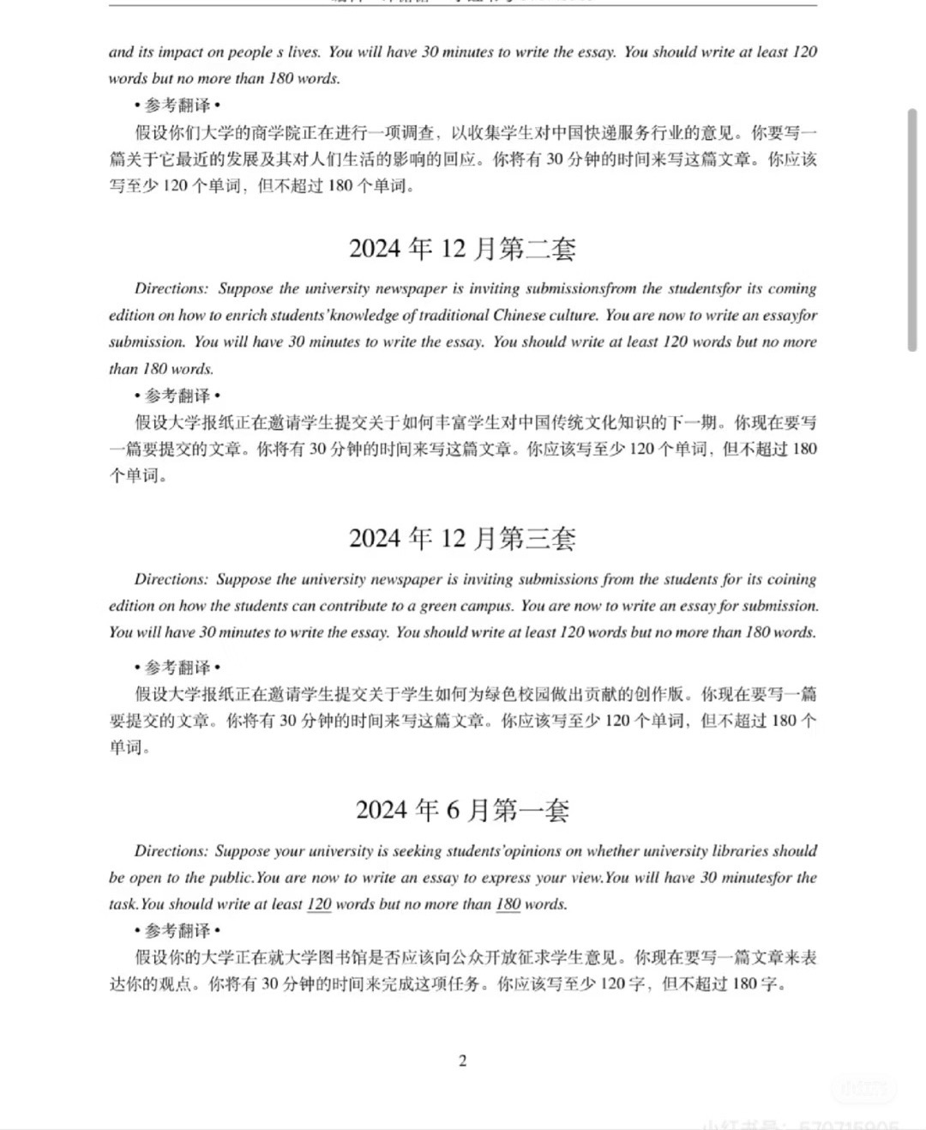

Slide 11
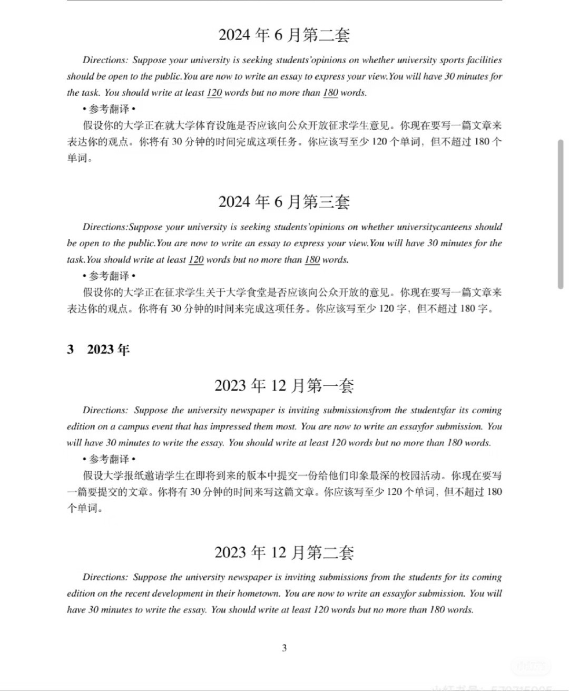

Slide 12
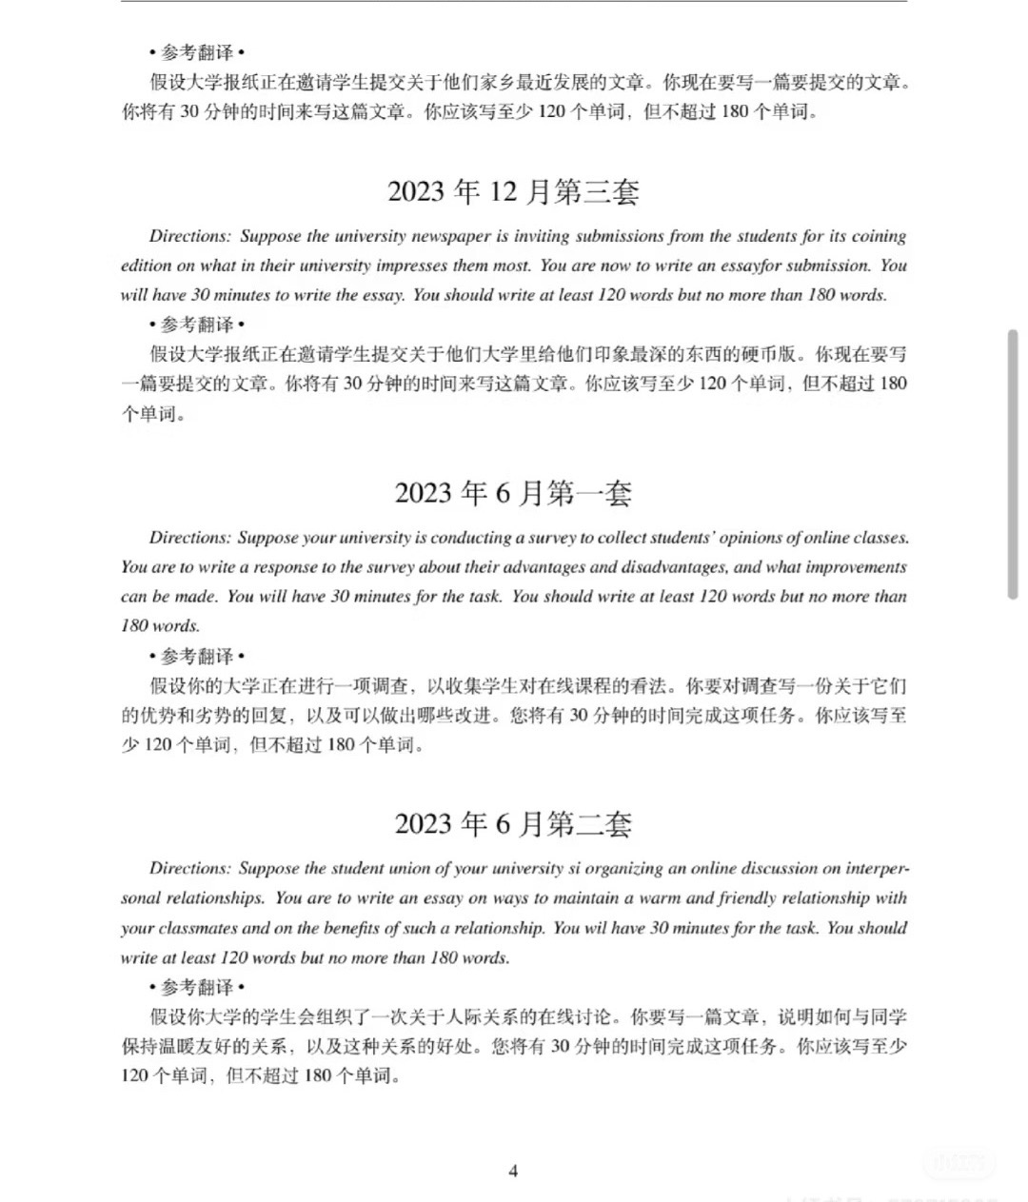

Slide 13
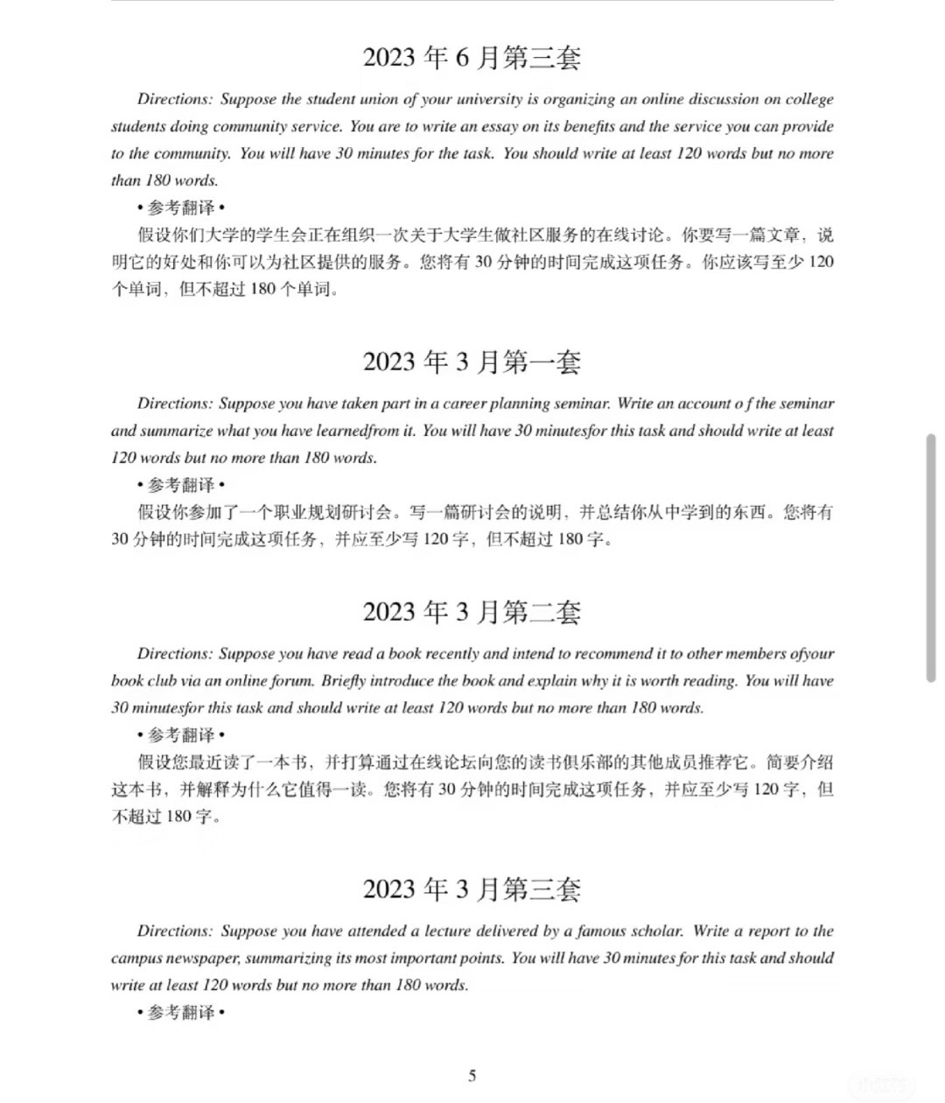

Slide 14
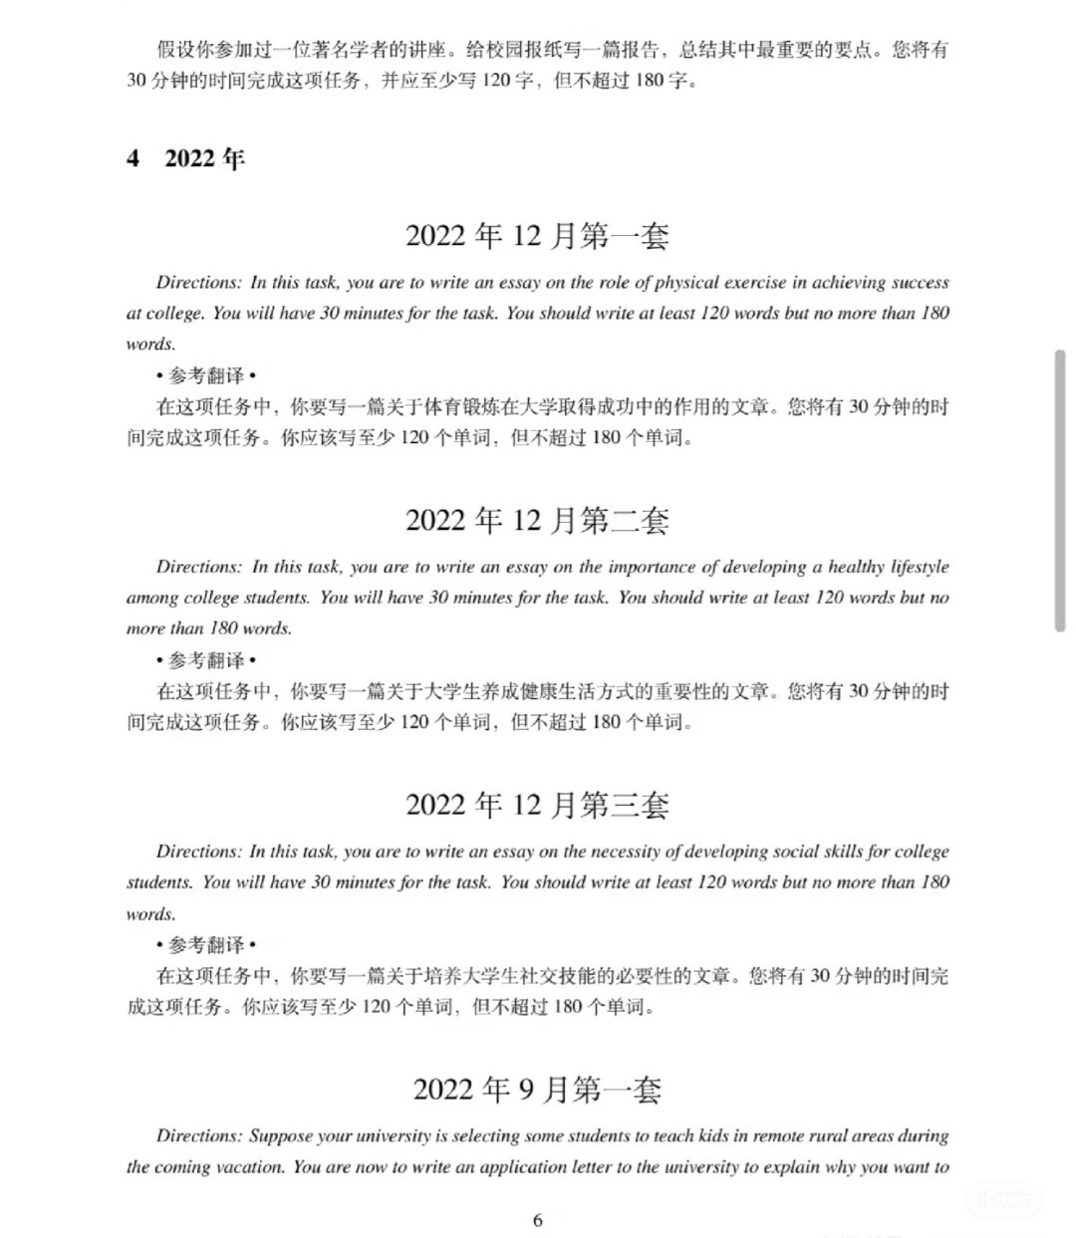

Slide 15
Scoring Criteria
Content: Relevance to the topic, coverage of main points, and depth of argumentation.
Organization: Logical flow, clear structure (introduction, body, conclusion), and effective transitions.
Language Use: Grammar, vocabulary, and sentence structure accuracy; higher scores for varied and precise language.
Mechanics: Spelling, punctuation, and adherence to formal writing conventions.

Slide 16
Time and Length Requirements
Time: Students have 30 minutes to complete the writing task.
Word Count: Essays should be around 120-180 words; going significantly under or over this range may affect scores.

Slide 17
Brainstorming and Structuring Ideas

Slide 18
Step 1: Brainstorming Key Points
Phenomenon Description
“What is the phenomenon I need to describe?”
“How does this phenomenon affect our lives or society?”
“What are the possible causes or consequences of this phenomenon?”
Example: 如果题目是描述某一社会现象，如“手机成瘾”，可列出该现象的定义、原因（如科技进步、社交需求）及其对个人和社会的影响。

Slide 19
Step 1: Brainstorming Key Points
Problem-Solution
“What specific problem is being addressed?”
“What are the main causes of this problem?”
“How to effectively address it?”
Example: 例如校园垃圾问题，学生可以列出成因（如缺乏环保意识、校园垃圾分类设施不完善）和具体解决方案（增加垃圾桶、开展环保宣传活动）。

Slide 20
Step 1: Brainstorming Key Points
Opinion Expression
“What is my stance on the topic?”
“Why do I hold this opinion? What supporting points can I provide?”
“Are there any potential counterarguments or limitations?”
Example: 对于“大学生兼职是否有益”这一题目，学生可以列出自己支持或反对的理由，如支持的原因包括增加社会经验、提高沟通能力等，或反对的原因如分散学习精力等。

Slide 21
Step 2: Structuring the Three-paragraph Essay
Introduction
Focus: 引出主题并简要概括核心观点。
Key Tips: 用1-2句话简洁引出话题，并以概括性的语言表明文章方向。
Example Prompts:
“What is the main topic, and why is it relevant?”
“How can I briefly introduce my stance or the problem?”

Slide 22
Writing a Strong Introduction
1. Hook the Reader
- Start with an engaging sentence: a question, a relevant quote, or an interesting fact.
- Example: “With the rapid rise of remote work, the debate on career choices has intensified.”
2. Introduce the Topic
- Provide context for the topic without giving away too much detail.
- Mention both sides briefly (e.g., pursuing passion vs. financial stability).
3. Present Your Thesis Statement
- Clearly state your main argument.
- Example Thesis: “While financial stability is essential, pursuing a career based on passion ultimately leads to greater fulfillment.”

Slide 23
Step 2: Structuring the Three-paragraph Essay
Body
Focus: 通过主要论点、现象描述或解决方案进行详细说明。
Structure: For Phenomenon Description: 描述该现象的原因和影响。
For Problem-Solution: 先简要概括问题，再列出1-2个具体解决方案。
For Opinion Expression: 提出并解释支持或反对的理由。
Key Tips:
Use Examples and Evidence: 用例子或数据来加强论点或描述。
Be Specific: 避免笼统，用具体的语言让读者清晰了解论点。
Example Prompts:
“What evidence or examples best illustrate my point?”
“How can I make my solutions clear and practical?”

Slide 24
Developing the Body Paragraphs
1. Start with a Topic Sentence
- Begin each paragraph with a sentence that introduces the main idea of that paragraph.
- Example: “One major benefit of pursuing passion in a career is increased motivation.”
2. Provide Supporting Evidence
- Use examples, facts, or personal experiences to back up your point.
- Example: “Studies show that individuals engaged in work they love experience lower stress and higher productivity.”
3. Explain and Analyze
- Explain how the evidence supports the topic sentence and main thesis.
- Connect the point to the essay’s overall argument.
4. Use Linking Words
- Ensure coherence by using transitions such as “Furthermore,” “For example,” and “In contrast.”

Slide 25
Step 2: Structuring the Three-paragraph Essay
Conclusion
Focus: 简洁总结论点或解决方案，结束时强调正面影响或期望的结果。
Key Tips: 总结时不必过于重复内容，重点是简洁地重申主题或中心观点。结尾可以呼吁行动或表达对未来的期待。
Example Prompts:
“How can I restate my main point or solution in a new way?”
“What positive or hopeful statement can I end with?”

Slide 26
Crafting an Effective Conclusion
1. Restate the Thesis (Paraphrased)
- Reaffirm your position with slightly different wording.
- Example: “Ultimately, while financial stability is important, career satisfaction comes from passion.”
2. Summarize Key Points
- Briefly review the main points from the body paragraphs.
- Example: “Choosing a career driven by passion can lead to higher motivation, productivity, and overall happiness.”
3. End with a Strong Closing Statement
- Finish with a memorable sentence or a call to action.
- Example: “In a world full of choices, pursuing what you love might be the most valuable one of all.”

Slide 27
Step 3: Practice with an Idea Organization Template
Section | Purpose | Prompts
Introduction | Briefly introduce the topic and give a preview of the essay | “What is the topic, and why does it matter?”
Body | Describe the phenomenon, problem, or viewpoint in detail | “What are the main points I want to make?” “What examples or solutions support my points?”
Conclusion | Summarize key points and add a positive or concluding thought | “How can I summarize my ideas in a few words?” “What final thought can I leave the reader with?”
Key tips for brainstorming and structuring:
1. Stay Focused on the Task Type: 确保内容符合题目类型（现象描述、问题解决、观点表达）。
2. Use Transition Words: 使用如 “Firstly,” “Therefore,” 和 “In conclusion”等过渡词使文章流畅。
3. Be Concise: 各部分保持简洁，重点突出核心观点和支持内容。
4. Revise for Clarity: 最后检查逻辑是否清晰、内容是否易于理解。

Slide 28
Sample Essay Structure

Slide 29
Sample Essay Structure
How to Reduce Plastic Waste on Campus
Plastic waste has become a significant issue on our campus. Each day, large amounts of plastic items, such as bottles, bags, and food containers, are discarded, creating an environmental challenge that must be addressed.
The main reason for the high level of plastic waste is the convenience of plastic products, such as bottles and bags, which are cheap and accessible. To address this issue, our campus could implement two strategies. Firstly, efforts should be made to encourage students to use reusable items by offering discounts at campus stores can reduce plastic use. Secondly, it would be beneficial to place recycling bins in convenient locations, making it easier for students to dispose of plastics responsibly.
In conclusion, by promoting reusable items and establishing recycling facilities, our campus can reduce plastic waste and foster a greener environment. Taking small steps today can make a big difference in the future.

Slide 30
Sample Essay Structure
Introduction (State the Problem)
Plastic waste has become a significant issue on our campus. Each day, large amounts of plastic items, such as bottles, bags, and food containers, are discarded, creating an environmental challenge that must be addressed.
明确问题：引言段直接指出校园塑料垃圾的问题。
写作技巧：通过强调问题的重要性（如 “must be addressed”）引出主题。

Slide 31
Sample Essay Structure
Body Paragraph (Analyze Causes and Propose Solutions)
The main reason for the high level of plastic waste is the convenience of plastic products, such as bottles and bags, which are cheap and accessible. To address this issue, our campus could implement two strategies. Firstly, efforts should be made to encourage students to use reusable items by offering discounts at campus stores can reduce plastic use. Secondly, it would be beneficial to place recycling bins in convenient locations, making it easier for students to dispose of plastics responsibly.
问题与解决方案整合：主体段先简要分析了原因，接着提出了两个具体的解决方案。
写作技巧：使用 “Firstly” 和 “Secondly” 使方案条理分明，并且段落内容紧凑。
句式多样化：使用复合句解释原因，提出行动方案时简洁明了，适合三段式写作的要求。

Slide 32
Sample Essay Structure
Conclusion (Reinforce Solution and Future Impact)
In conclusion, by promoting reusable items and establishing recycling facilities, our campus can reduce plastic waste and foster a greener environment. Taking small steps today can make a big difference in the future.
总结方案：结论段重申了提出的解决方案。
强调影响：通过 “make a big difference” 呼应开头，凸显方案的意义。
语言简洁：三段式写作中的结论通常简明扼要，既概括观点又给出鼓舞性结尾。

Slide 33

Key Points for Three-paragraph Writing
Concise Structure: 使用三段式结构时，主体段结合原因分析和解决方案， 内容紧凑。
Clarity and Logic: 通过过渡词和序列词，使得每一步都清晰易懂。
Impactful Conclusion: 结尾段总结观点并表达积极展望，增强文章的整体效果。

Slide 34
Essential Phrases and Expressions for CET Writing
Expressing Reasons: because of, due to, as a result of
Stating Opinions: I believe that, In my opinion, From my perspective
Making Comparisons: On the one hand, In contrast, However
Supporting or Disagreeing: It is beneficial to, I am against the idea that, I fully support the view that
Transition Phrases: Firstly, Moreover, Furthermore, Finally, In conclusion

Slide 35
Assignment

Slide 36

Assignment
Requirements: You are required to write a 120-180 word essay that states your position, includes supporting points, and provides a brief conclusion.
Topic: Write an essay to express your views on the development of students’ cross-cultural communication abilities.
Criteria:
1) Structure: Did the essay follow the three-part format? Were ideas logically organized?
2) Content: Were points relevant to the topic? Were they explained clearly?
3) Language: Did they use accurate vocabulary, grammar, and transition words?
作文号为：3307352

